Slide 1
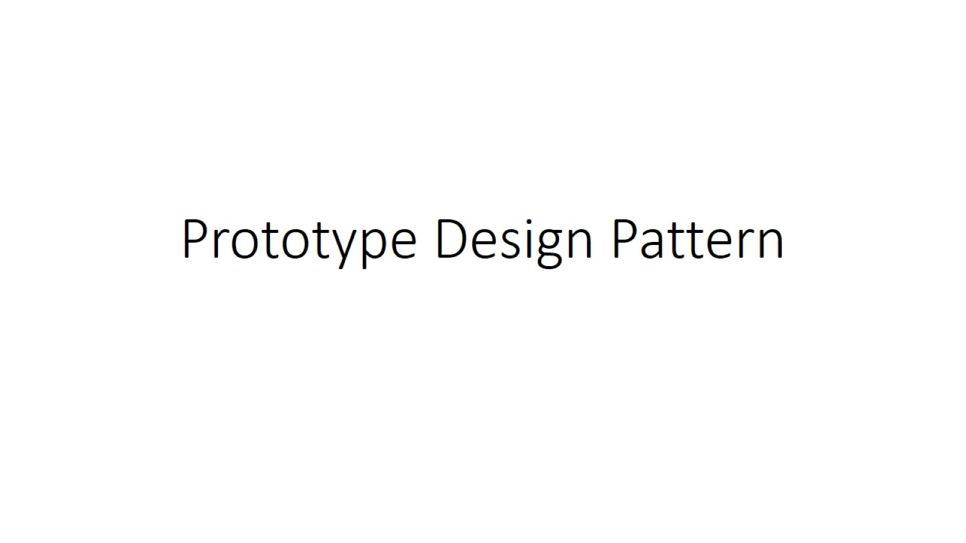
Prototype Design Pattern

Slide 2
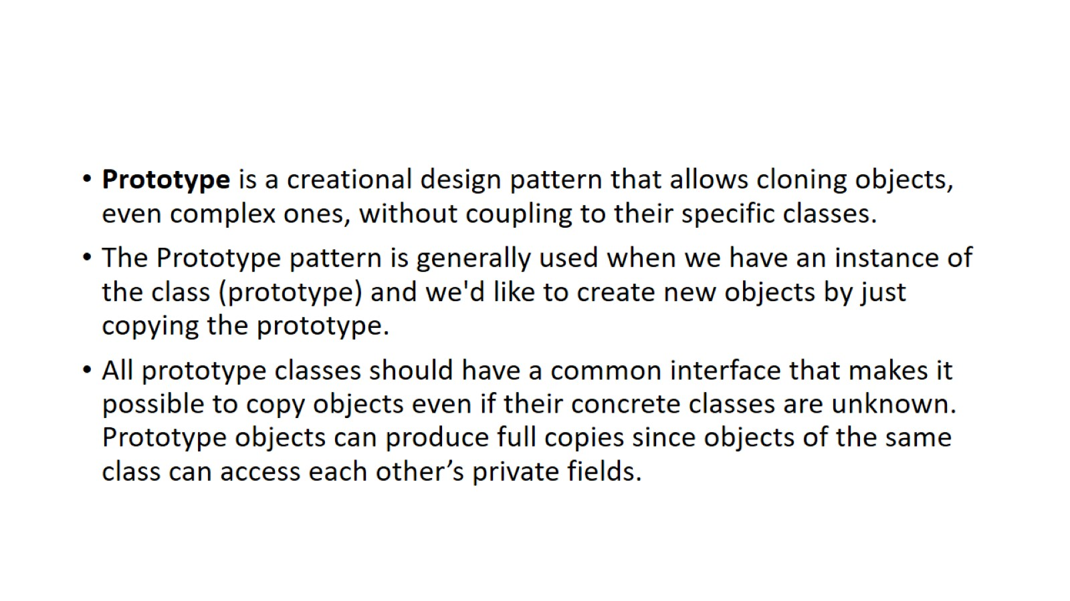

Slide 3
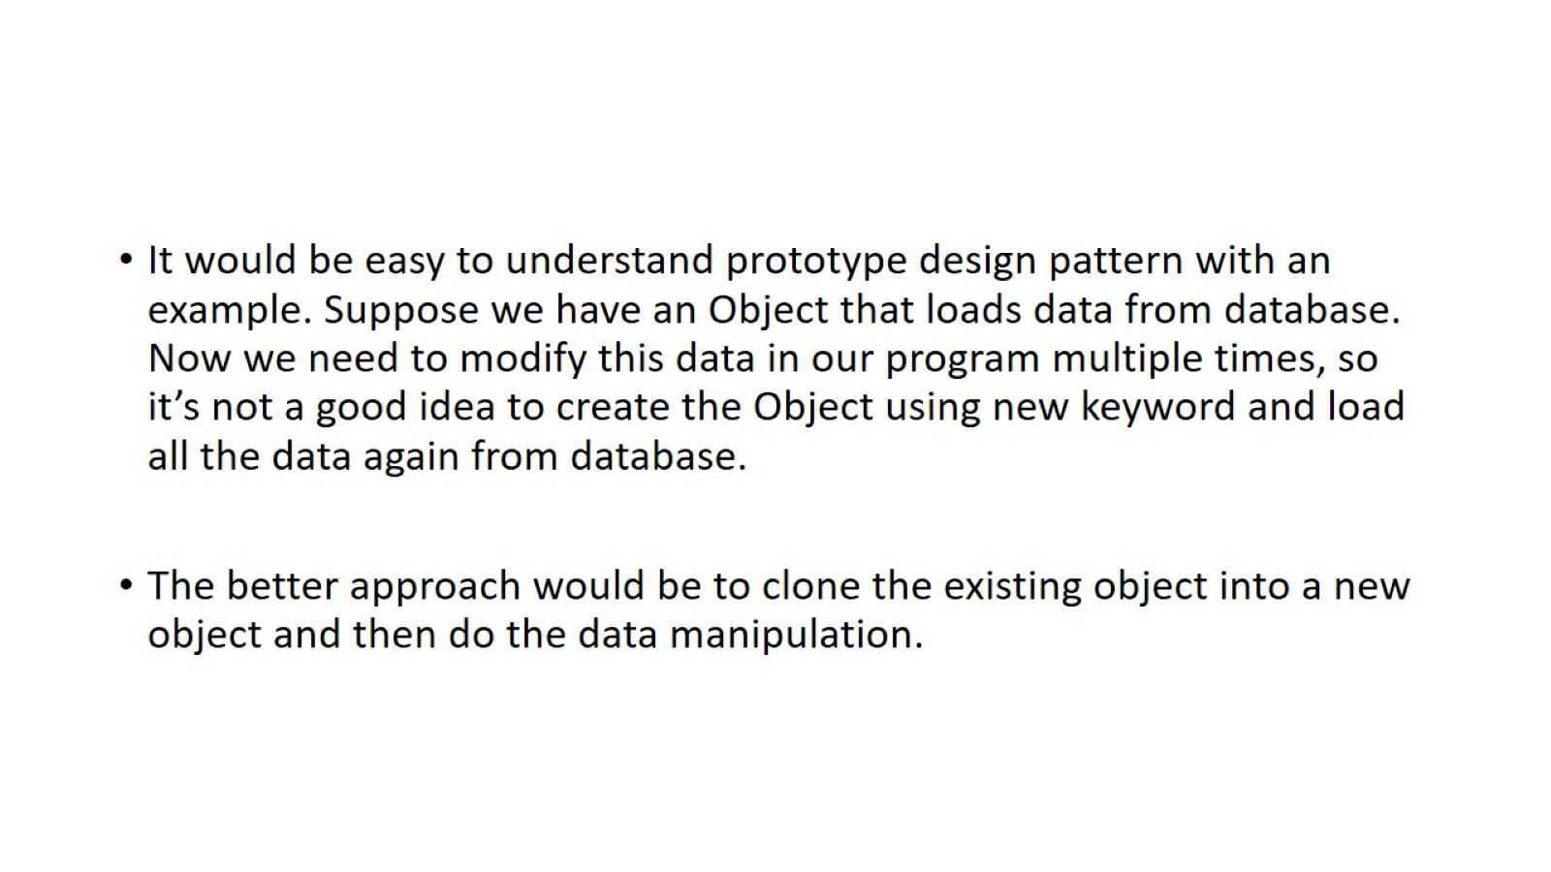

Slide 4
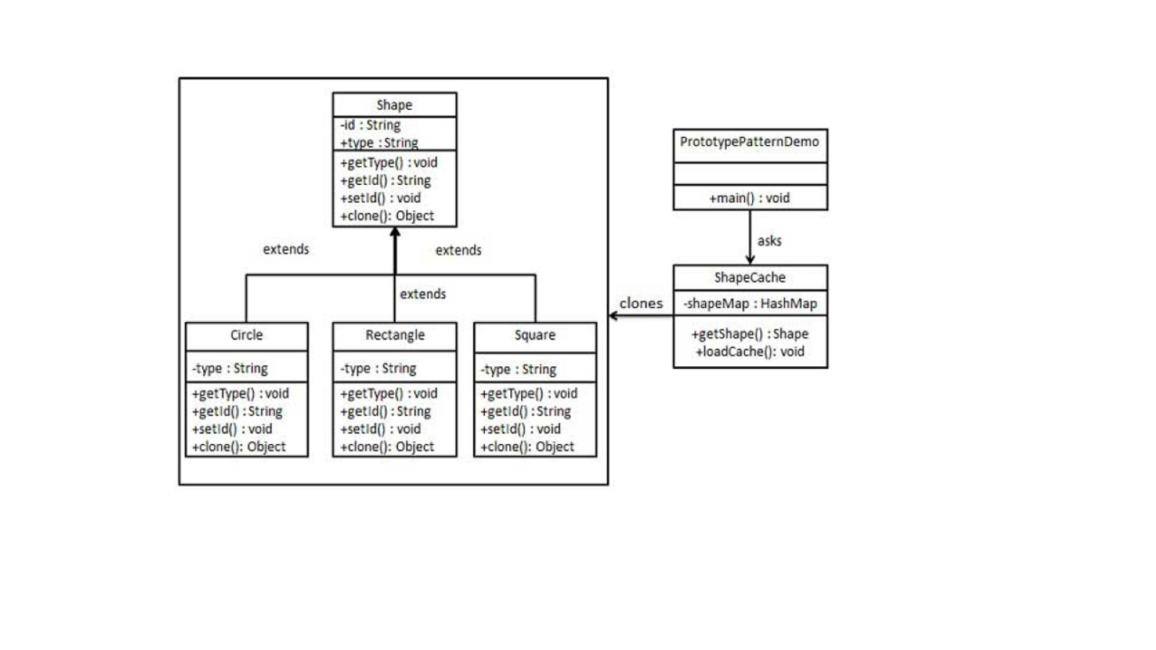

Slide 5
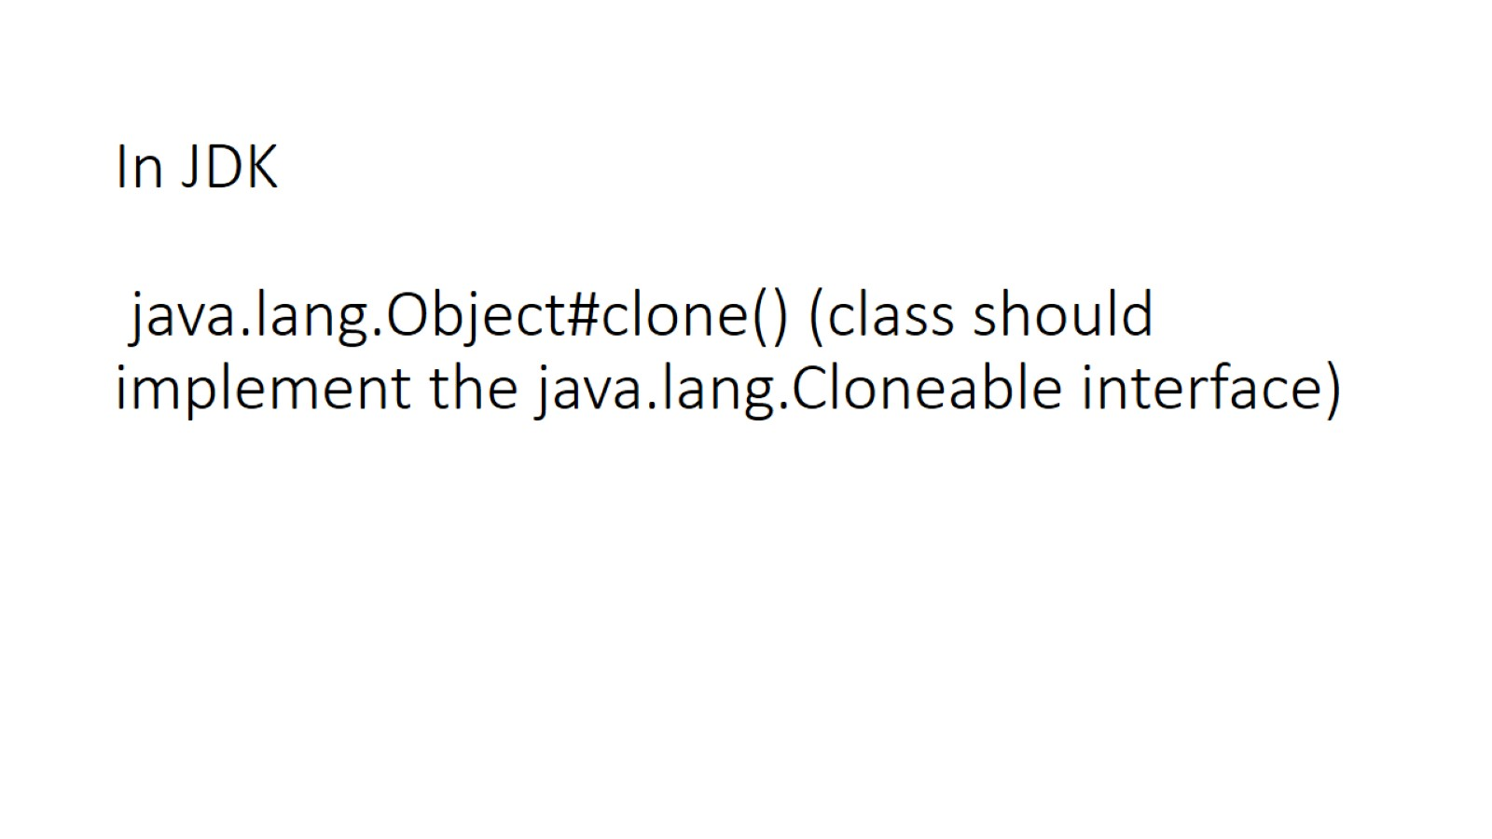
In JDK java.lang.Object#clone() (class should implement the java.lang.Cloneable interface)

